Slide 1
Sheet Metal Forming Process
Lecture 16

Slide 2
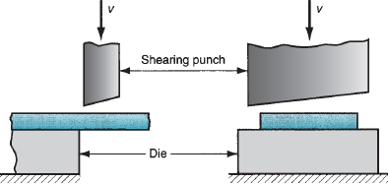
Sheet Metal Forming Operations
Sheet metal forming involves the plastic deformation of sheets.
Cutting
  Shearing to separate large sheets
  Blanking to cut part perimeters out of sheet metal
  Punching/ Piercing to make holes in sheet metal
Bending
  Straining sheet around a straight axis
Drawing
  Forming of sheet into convex or concave shapes
Shearing

Slide 3
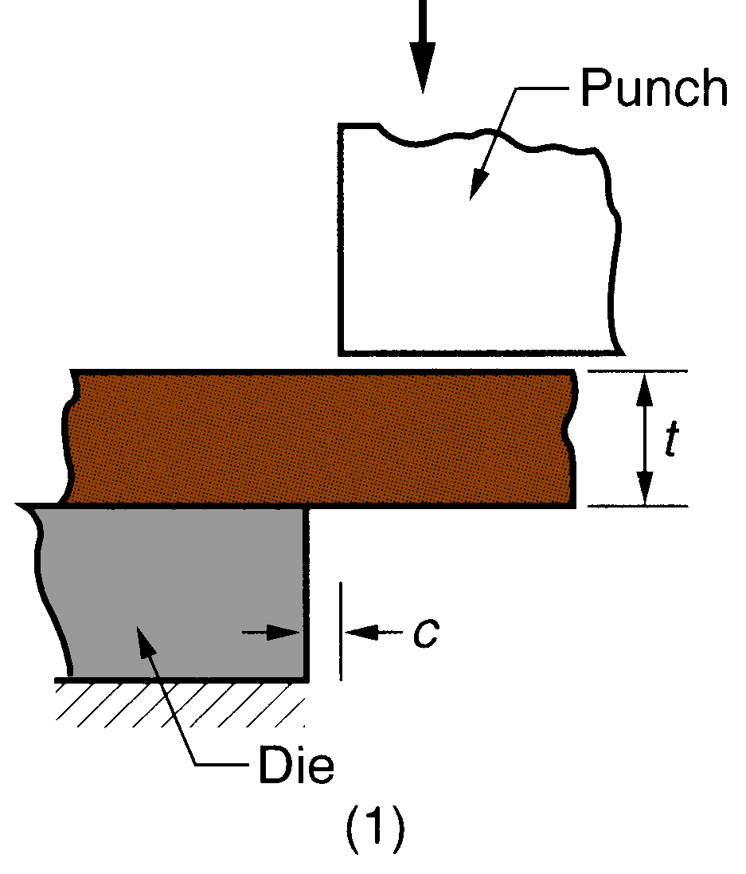
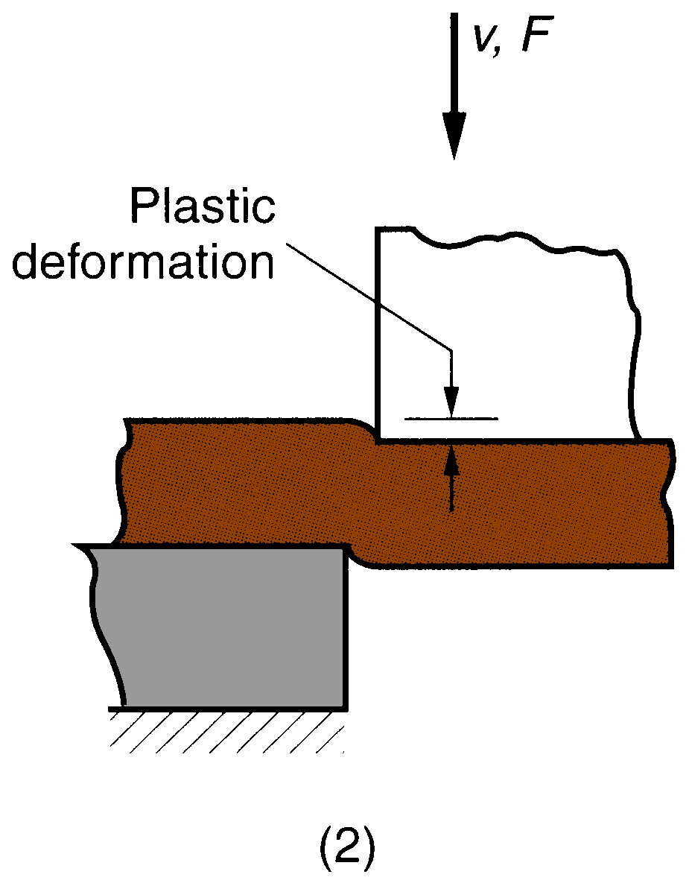
Sheet Metal Cutting - Shearing
Shearing of sheet metal between two cutting edges: (1) just before the punch contact work;
(2) punch begins to push into work, causing plastic deformation;

Slide 4
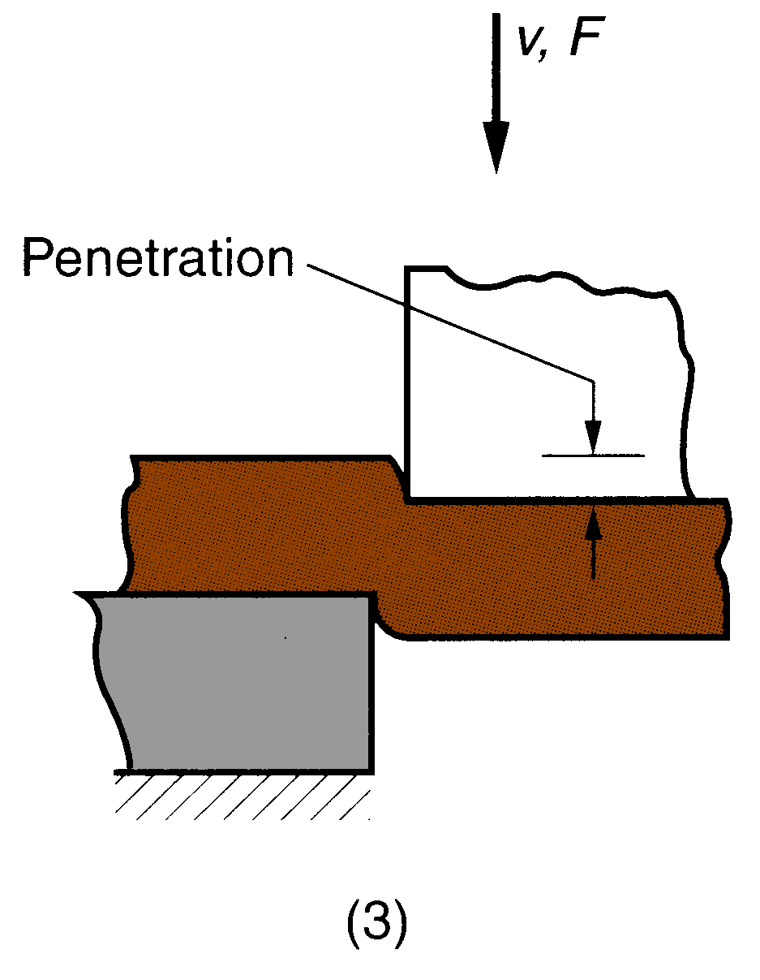
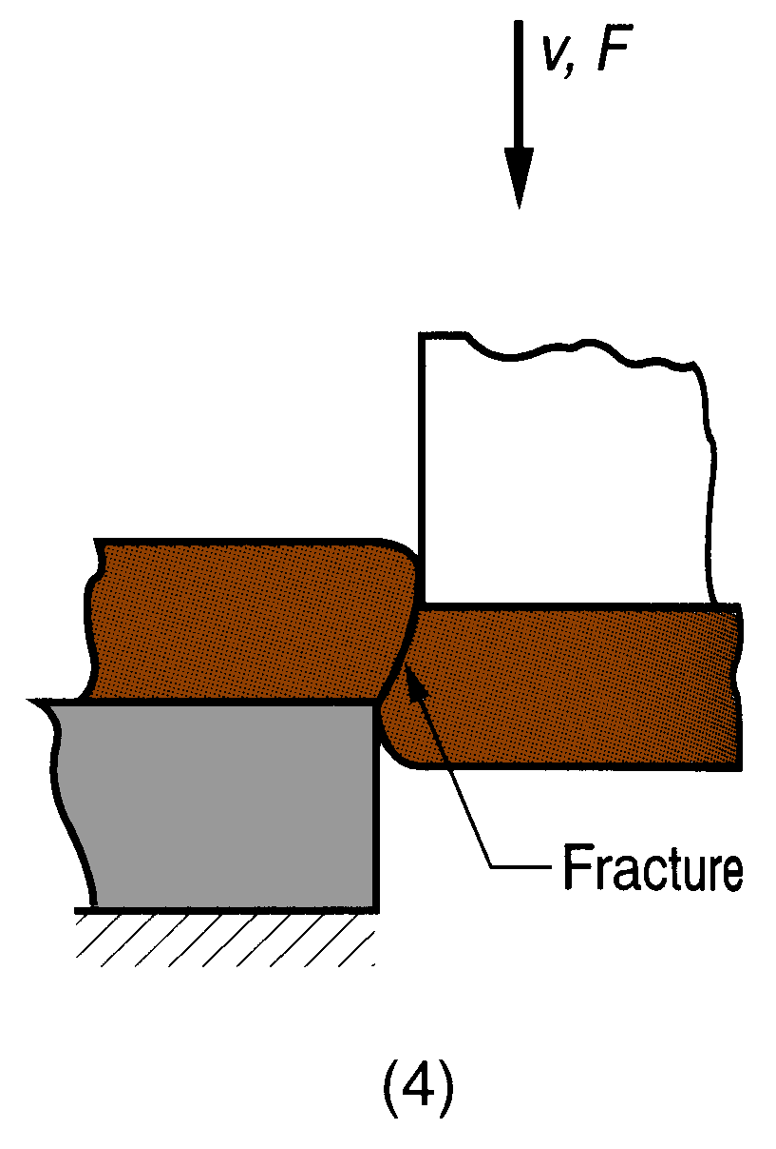
Sheet Metal Cutting - Shearing
Shearing of sheet metal between two cutting edges:
(3) Punch compresses and penetrates into the work, causing a smooth cut surface;
(4) Fracture is initiated at the opposing cutting edges, which separate the sheet.

Slide 5
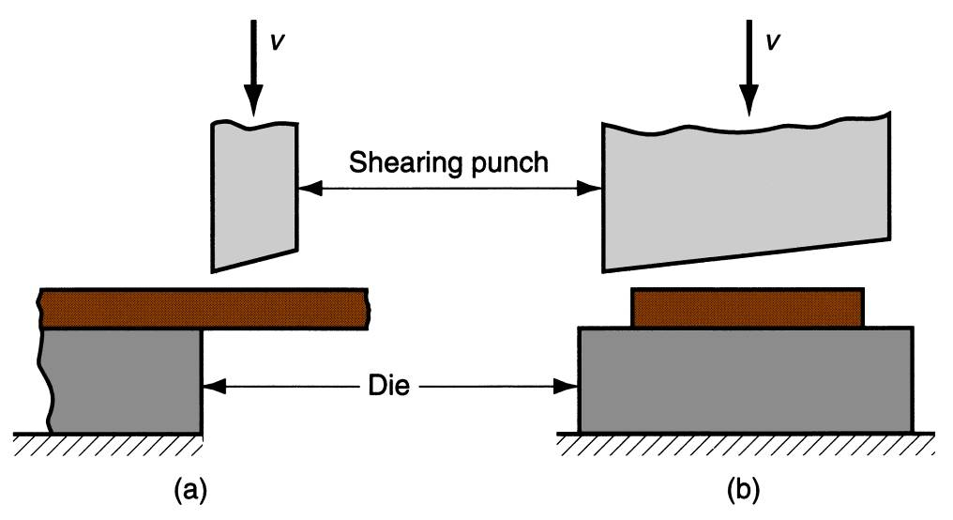
Shearing
Sheet metal cutting operation along a straight line between two cutting edges
Typically used to cut large sheets
Engagement of the entire blade into cutting requires higher forces.
Therefore, an inclined blade is used to reduce force and to improve the cut-edge.
Shearing operation: (a) side view of the shearing operation; (b) front view of power shears equipped with an inclined upper cutting blade.
Notes:
Engagement of entire blade into cutting need higher forces. Therefore, inclined blade is used to reduce force.

Slide 6
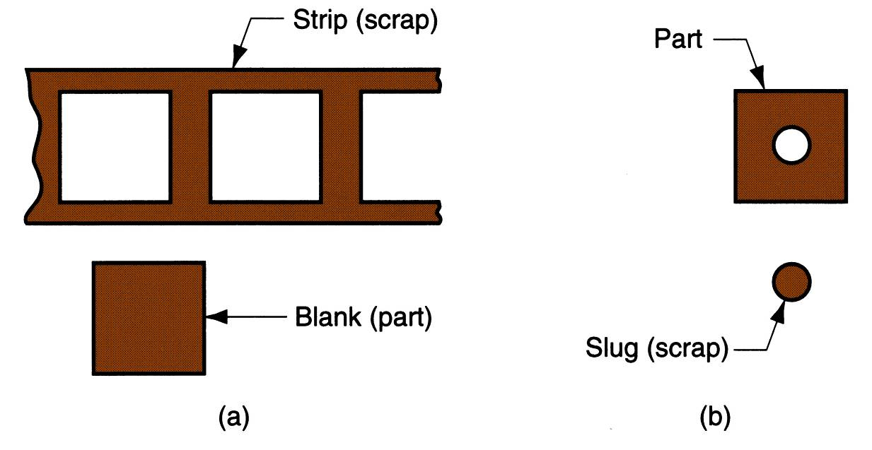
Blanking and Punching
Blanking - sheet metal cutting to separate a piece (called a blank) from the surrounding stock
Punching is a metal fabricating process that removes a scrap slug from the metal workpiece each time a punch enters the punching die.
This process leaves a hole in the metal workpiece
(a) Blanking and (b) punching.

Slide 7

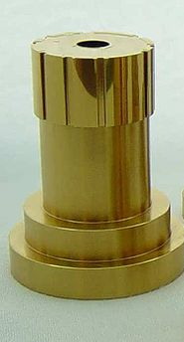
Punching and Piercing
Punching tool
….
……..
Piercing tool
Bur
Punching
Piercing
Slug is cut and the bur is minimal
No slug is cut, only bur
Notes:
3. … This is not to say the punched material will not have a burr, but the pierced holes will have a significantly more pronounced bur

Slide 8
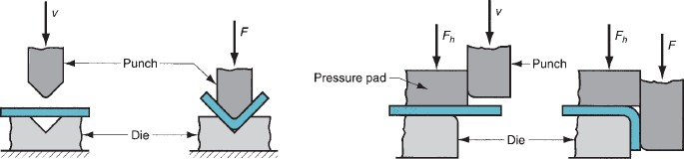
Types of Sheet Metal Bending
V‑bending - performed with a V‑shaped die
For low production
Performed on a brake press
V-dies are simple and inexpensive
V-bending
Edge bending - performed with a wiping die
For high production
Pressure pad required
Dies are more complicated and costly
Edge bending

Slide 9
Stretching during Bending
If the bend radius is small relative to the stock thickness, the metal tends to stretch during bending
Important to estimate the amount of stretching, so that the final part length can be obtained as the specified dimension

Slide 10
Drawing
Sheet metal forming to make cup‑shaped, box‑shaped, or other complex‑curved, hollow‑shaped parts
The sheet metal blank is positioned over the die cavity, and then the punch pushes the metal into the opening
Products: beverage cans, ammunition shells, automobile body panels
Also known as deep drawing (to distinguish it from wire and bar drawing)

Slide 11
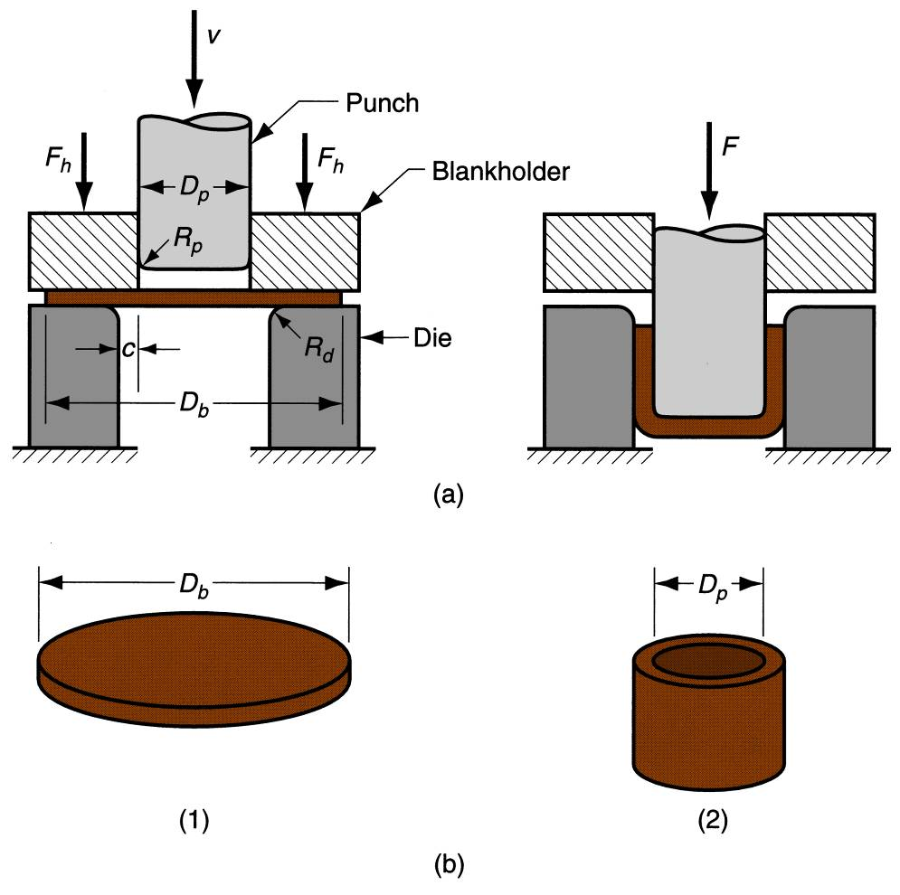
Drawing
Difference between wire drawing & deep drawing?
(a) Drawing of cup‑shaped part: (1) before punch contacts work, (2) near end of stroke; (b) work-part: (1) starting blank, (2) drawn part.

Slide 12
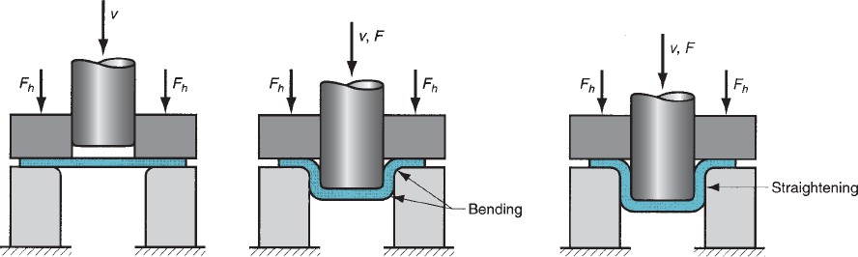
Stages in Deep Drawing
Stage I: As the punch pushes the sheet, it is subjected to a bending operation. Bending of the sheet occurs over the punch corner and the die corner. The outside perimeter of the blank moves slightly inwards toward the cup center
Stage II: In this stage, the sheet region that was bent over the die corner will be straightened in the clearance region at this stage, so that it will become a cup wall region. In order to compensate for the presence of the sheet in the cup wall, more metal will be pulled from the sheet edge, i.e., more metal moves into the die opening.
Stage III: Friction between the sheet and the die, blank holder surfaces restrict the movement of the sheet into the die opening. The blank holding force also influences the movement. Lubricants or drawing compounds are generally used to reduce friction forces.
Stage I
Stage II
Stage III

Slide 13
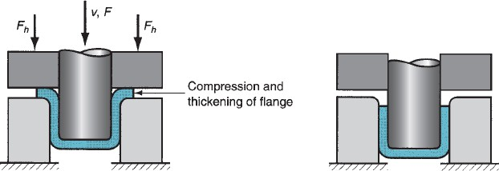
Stages in Deep Drawing
Stage IV: Other than friction, compression occurs at the edge of the sheet. Since the perimeter is reduced, the sheet is squeezed into the die opening. Because volume remains constant, with a reduction in perimeter, thickening occurs at the edge.
In thin sheets, this is reflected in the form of wrinkling. This also occurs in the case of low blank holding force. If BHF is very small, wrinkling occurs. If it is high, it prevents the sheet from flowing properly toward the die hole, resulting in stretching and tearing of the sheet.
Stage V: The final cup part will have some thinning in the side wall.
Stage IV
Stage V

